Slide 1
AIO Steganography Tool
Major Project
M.C.A.(2021-2023) Fourth Semester
Department of Computer Science
Faculty of Natural Sciences
Jamia Millia Islamia
M
Submitted by :
Nadra Ibrahim (21MCA033)

Slide 2

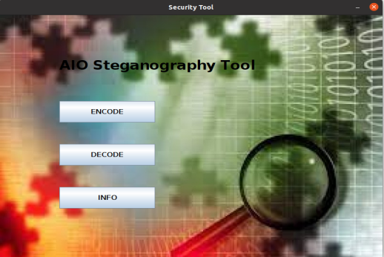

AIO Steganography Tool
An AIO (All-in-One) steganography application is a desktop application used for securing and transmitting sensitive information(text, image) by embedding it within inconspicuous cover files(image, video or audio).

Slide 3

Information Hiding :

Slide 4

Career highlights
Why Steganography?
The advantage of steganography over cryptography alone is that the intended secret messages does not attract attention to itself an object of scrutiny.
While encrypted messages no matter how unbreakable arouse interest.

Slide 5
LSB Algorithm

Slide 6
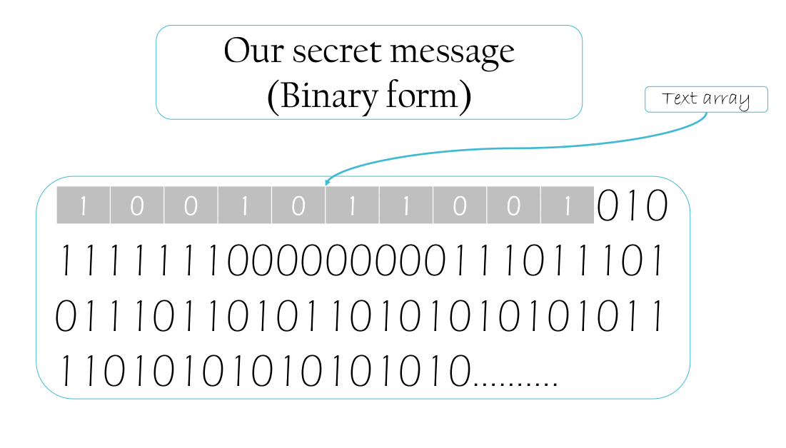

Slide 7
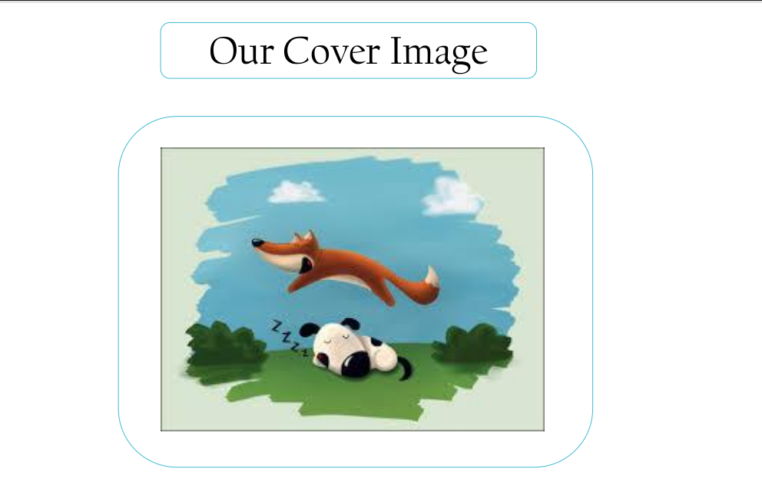

Slide 8
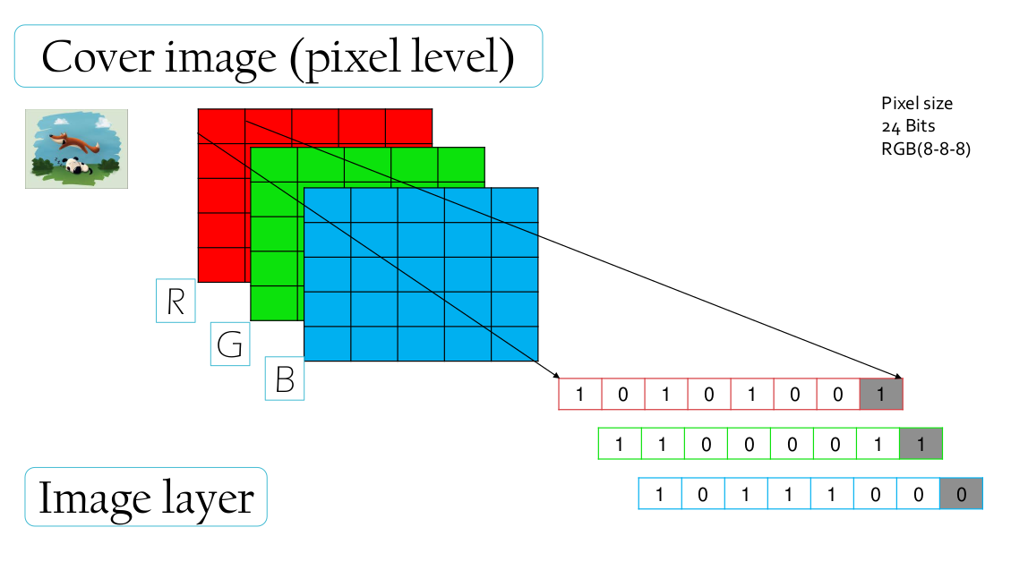

Slide 9
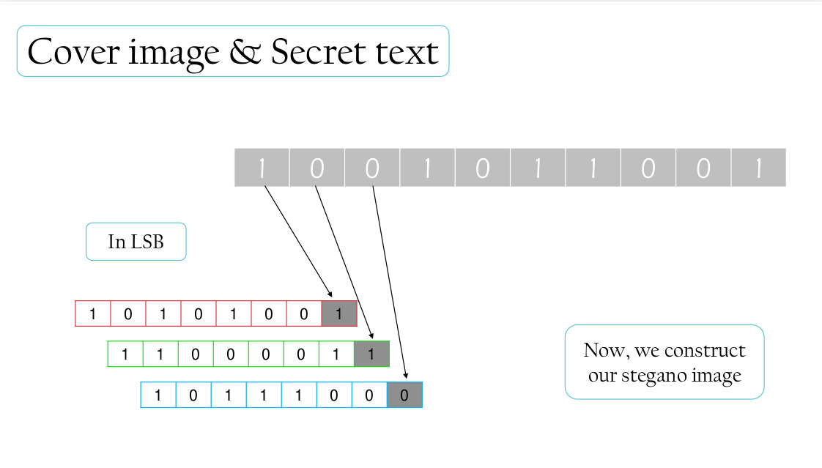

Slide 10
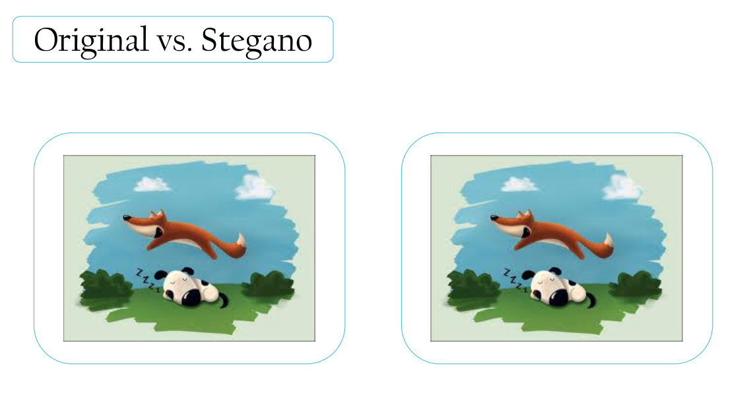

Slide 11
AIO STEGANOGRAPHY

Slide 12
AIO Steganography Tool
An AIO (All-in-One) steganography application is a specific type of steganography tool that encompasses various steganography techniques and features in a single application.
Audio Steganography
Image
Steganography
Text
Steganography
Video
Steganography

Slide 13
1. Image Steganography :
Embedding secret data into the pixels of an image in a way that is imperceptible to the human eye.
i. Encoding Image into Image :
Technique : LSB substitution
Convert the cover image and secret image to binary format
Take the least significant bits of the cover image block and replace them with the most significant bits of the secret image block.
Obtain the modified cover image block.
Combine all the modified cover image blocks to create the stego image.

Slide 14
ii. Encoding text into Image :
Technique : DES + LSB
LSB substitution and DES (Data Encryption Standard) is combined to encode text into an image with an additional layer of encryption and security. First the message is encrypted using DES algorithm and then the cypher text is hidden in the image.
The DES (Data Encryption Standard) algorithm is a symmetric-key block cipher . The algorithm takes the plain text in 64-bit blocks and converts them into ciphertext using 48-bit keys.
Since it’s a symmetric-key algorithm, it employs the same key in both encrypting and decrypting the data. If it were an asymmetrical algorithm, it would use different keys for encryption and decryption.

Slide 15
2. Audio Steganography :
Technique : Randomized LSB substitution
Randomized Least Significant Bit (LSB) substitution is a modification of the basic LSB steganography algorithm. In Randomized LSB steganography, instead of sequentially embedding the secret message in the LSBs of consecutive pixels, random data locations within the cover image are selected for storing the message bits. This adds an extra layer of randomness and makes it harder for someone to detect the hidden message by analyzing the LSB patterns.

Slide 16
3. Video Steganography :
Technique : RC4 + Frame-level steganography
Encryption using RC4: The plaintext data is encrypted using the RC4 algorithm. The RC4 key stream is generated based on a secret key. Each byte of the plaintext is XORed with a corresponding byte from the RC4 keystream to produce the ciphertext.
Frame-level steganography: The video file, is divided into frames. Each frame consists of a grid of pixels. The ciphertext generated from the RC4 encryption is then embedded within the frames of the video file by modifying the LSBs of selected pixels in each frame.

Slide 17
TECHNOLOGIES USED

Slide 18
Application Development Environment :
For building AIO Steganography(desktop application with a graphical user interface), following technologies were used.
Language:
Java
IDE:
IntelliJ
GUI Toolkit:
Swing
Version Control:
Github

Slide 19
Java is well-suited for the development of desktop applications, thanks to its robustness, platform independence, and rich set of libraries and frameworks.
Swing is a GUI (Graphical User Interface) toolkit for Java that allows developers to create desktop applications with a rich set of components and features.
IntelliJ IDEA is widely used for Java development, offering advanced features for coding, debugging, and testing Java applications.
GitHub is a web-based hosting service for version control using Git. IntelliJ IDEA has built-in support for version control systems like Git.

Slide 20
DEMONSTRATION

Slide 21
HOME

Slide 22
Home Window

Slide 23
ENCODE

Slide 24
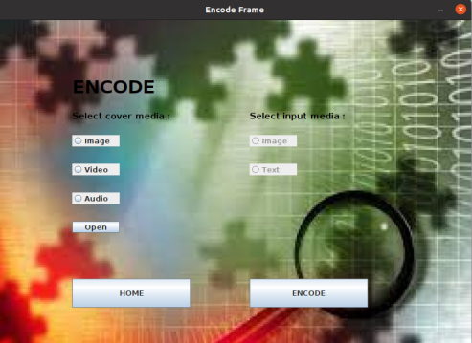
Encode Window

Slide 25
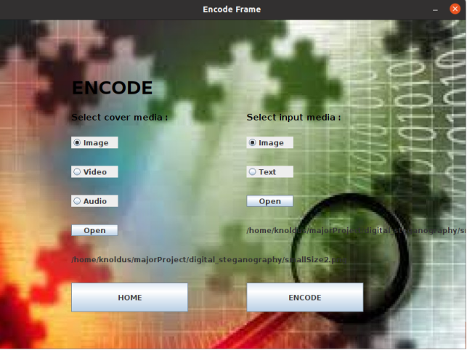
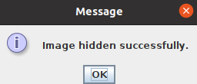
1. Encoding image into image

Slide 26
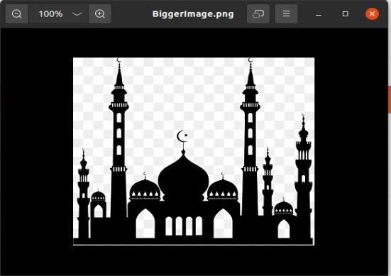
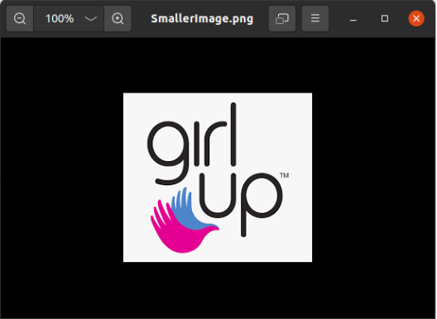
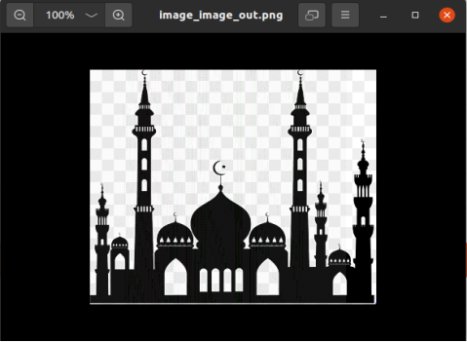
Cover Image
Secret Image
Stego Image

Slide 27

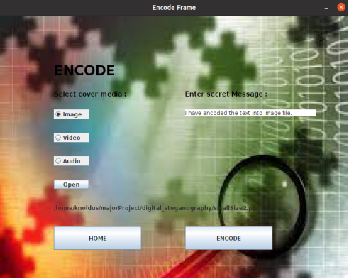
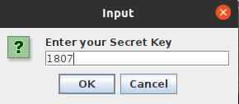
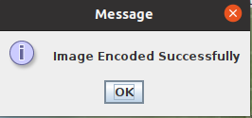

2. Encoding text into image
Prompt messages

Slide 28
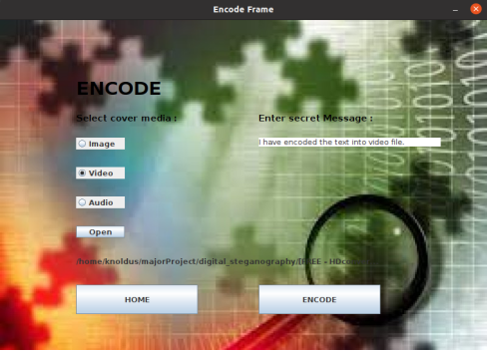
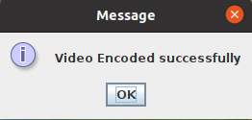
3. Encoding text into video
Prompt messages

Slide 29

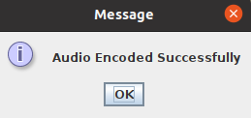
4. Encoding text into audio

Slide 30
DECODE

Slide 31
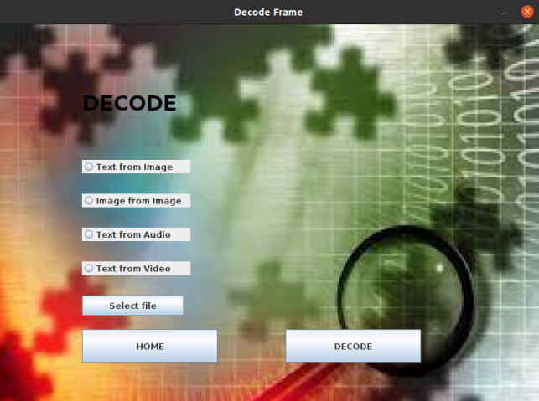
Decode Window

Slide 32
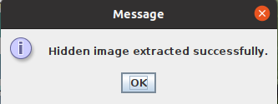
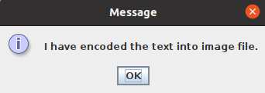
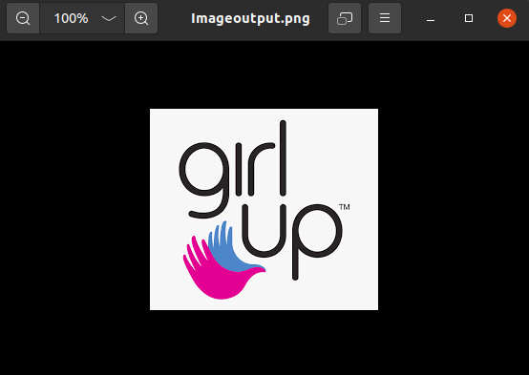
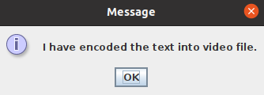
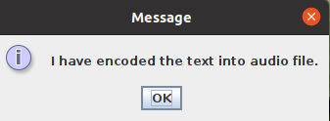
1. Image from Image :
2. Text from Image :
Extracted Image :
3. Text from Video :
4. Text from Audio :

Slide 33
INFO

Slide 34
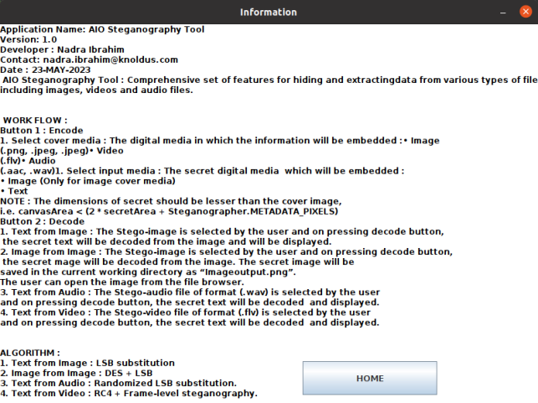

Slide 35
Refrences
SourceURL:file:///home/knoldus/Downloads/NadraIbrahimMCA4SemProjectReportFinal.docx
[1] B. Saha and S. Sharma, “Steganographic Techniques of Data Hiding using Digital Images”, in Defence Science Journal, vol. 62, no. 1, 2012 January, pp. 11-18.
[2] Silman, J., “Steganography and Steganalysis: An Overview”, SANS Institute, 2001.
[3] Jamil, T., “Steganography: The art of hiding information in plain sight”, IEEE Potentials, 18:01, 1999.
[4] Johnson, N.F. & Jajodia, S., “Exploring Steganography: Seeing the Unseen”, Computer Journal, February 1998.
[5] Sei-ichiro Kamata, et al: Depth-First Coding for Multi-Valued Pictures Using Bit-Plane Decomposition, IEEE Trans. on CT, Vol.43, No.5, pp.1961-1969, May, 1995.
[6] https://www.w3.org/TR/PNG-Chunks.html

Slide 36
I appreciate your attention.
Thank you.

